Slide 1

Theory of Production
Production involves transformation of inputs such as capital, equipment, labor, and land into output - goods and services
In this production process, the manager is concerned with efficiency in the use of the inputs
  - technical vs. economical efficiency
Two Concepts of Efficiency
Economic efficiency:
  occurs when the cost of producing a given output is as low as possible
Technological efficiency:
  occurs when it is not possible to increase output without increasing inputs
You will see that basic production theory is simply an application of constrained optimization:
the firm attempts either to minimize the cost of producing a given level of output
or
to maximize the output attainable with a given level of cost.
Both optimization problems lead to same rule for the allocation of inputs and choice of technology

Slide 2

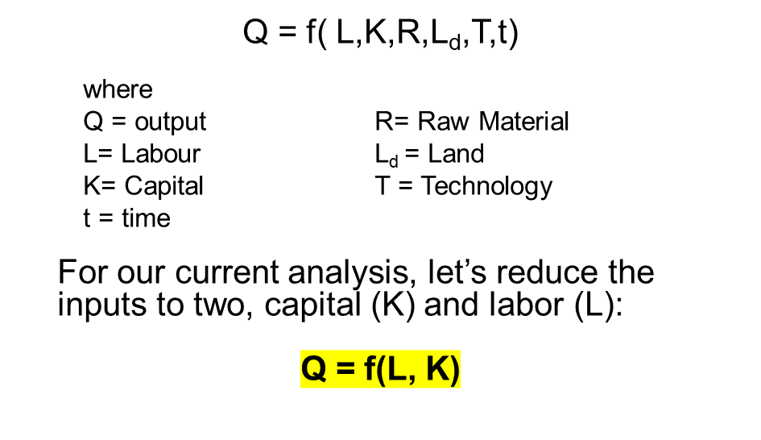
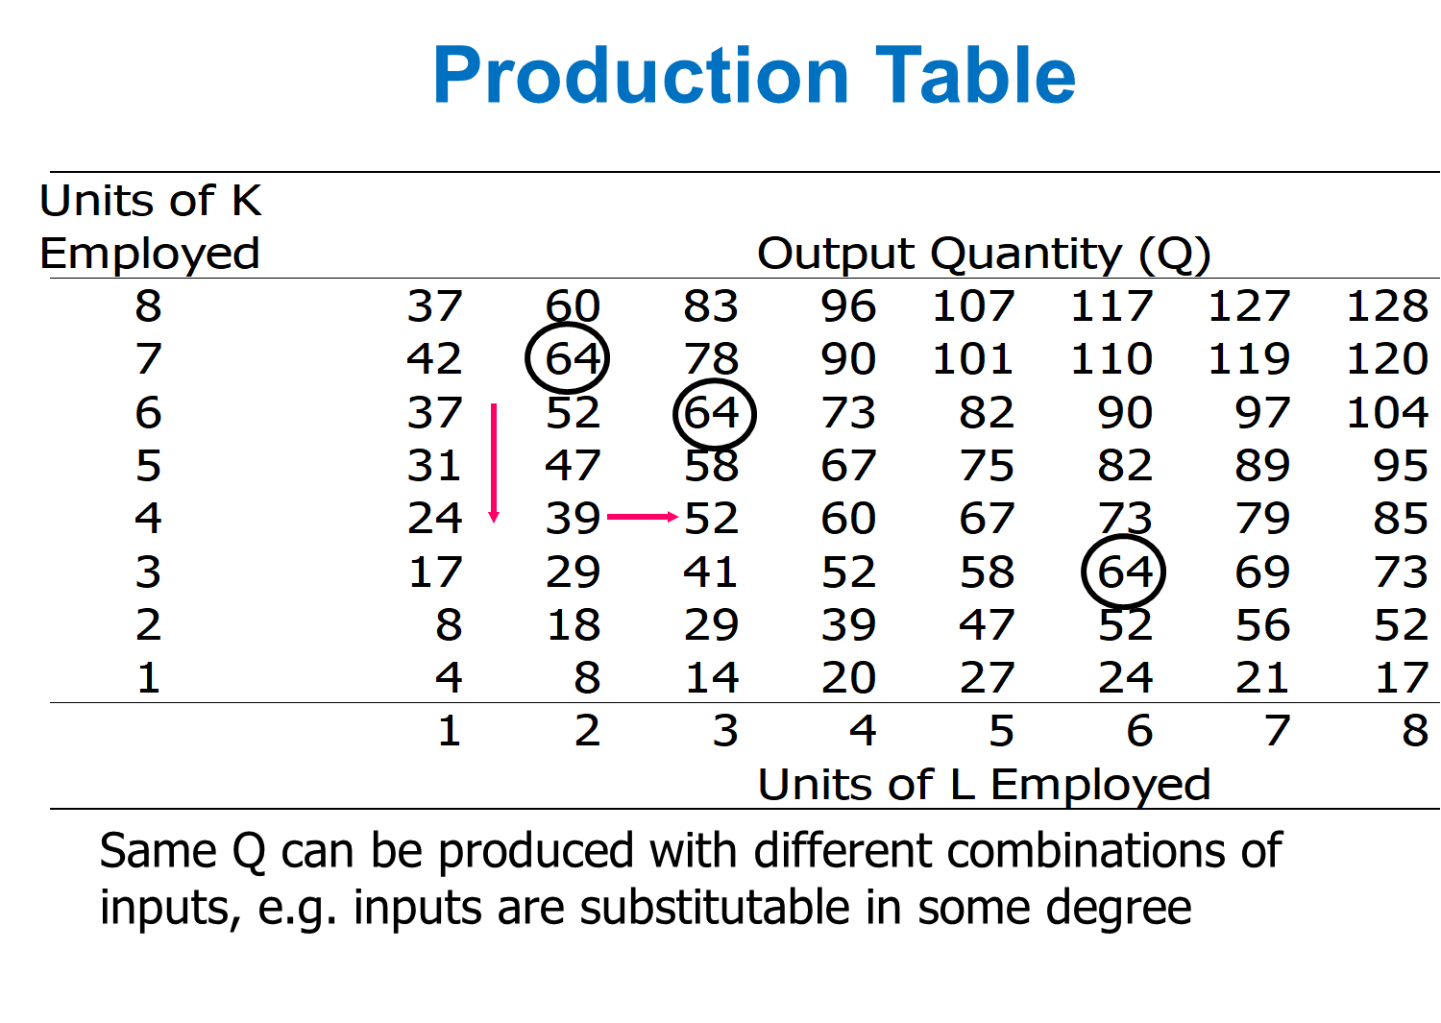
A production function is purely technical relation which connects factor inputs & outputs. It describes the transformation of factor inputs into outputs at any particular time period.

Slide 3
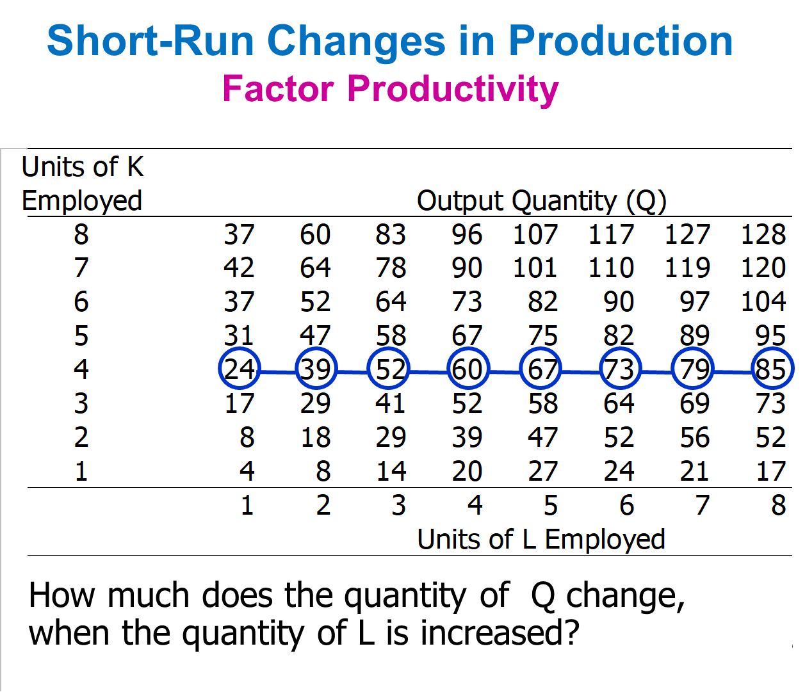
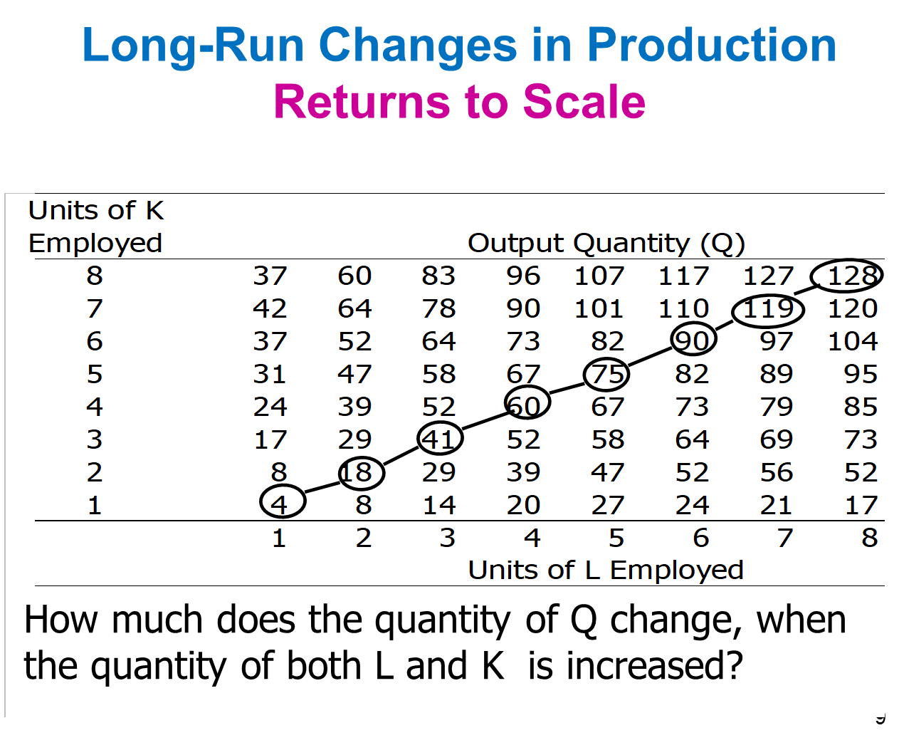
In the short run some inputs are fixed and some variable
  e.g. the firm may be able to vary the amount of labor, but cannot change the amount of capital
  in the short run we can talk about
  factor productivity / law of variable proportion/law of diminishing returns
In the long run all inputs become variable
  e.g. the long run is the period in which a firm can adjust all inputs to changed conditions
  in the long run we can talk about returns to scale

Slide 4
Relationship Between Total, Average, and Marginal Product: Short-Run Analysis
Total Product (TP) = total quantity of output
Average Product (AP) = total product per total input
Marginal Product (MP) = change in quantity when one additional unit of input used
The marginal product of labor is the increase in output obtained by adding 1 unit of labor but holding constant the inputs of all other factors
Marginal Product of L:
MP_{L}= ΔQ/ΔL (holding K constant)
= δQ/δL
Average Product of L:
AP_{L}= Q/L (holding K constant)
The law of diminishing returns states that when more and more units of a variable input are applied to a given quantity of fixed inputs, the total output may initially increase at an increasing rate and then at a constant rate but it will eventually increases at diminishing rates.
Assumptions. The law of diminishing returns is based on the following assumptions:
the state of technology is given
labour is homogenous and
input prices are given.

Slide 5
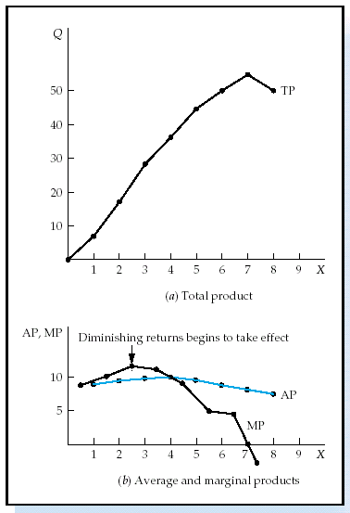

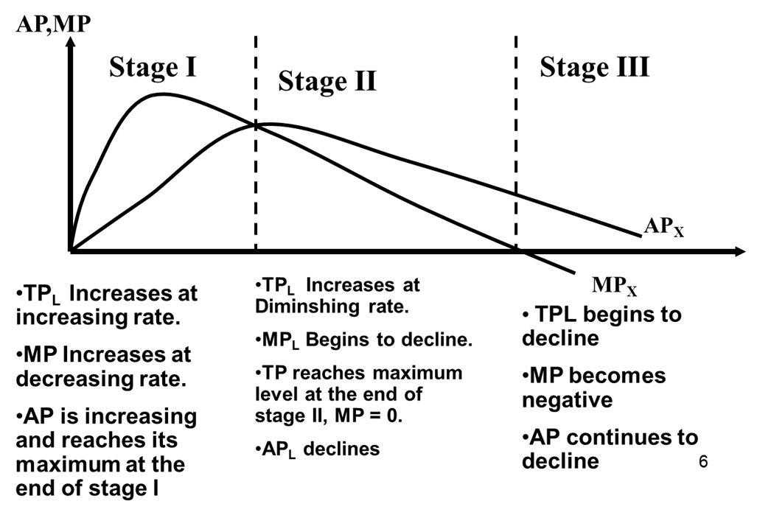
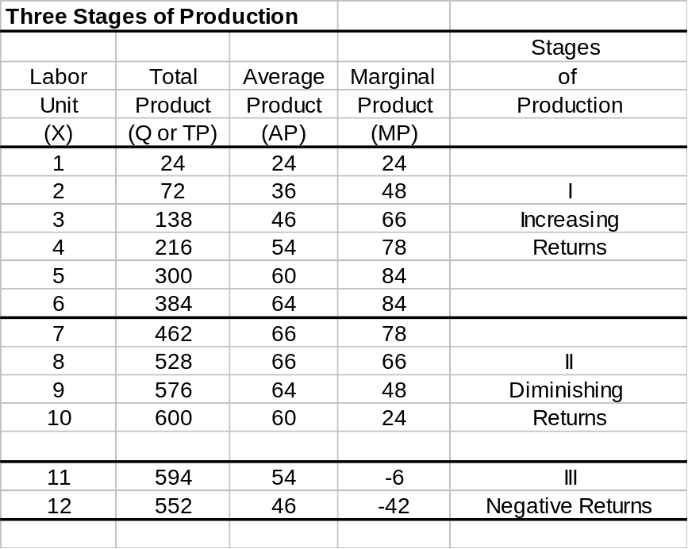
If MP > AP then AP is rising
If MP < AP then AP is falling
MP = AP when AP is maximized
TP maximized when MP = 0
Operational stage-producer choose btw stage 2

Slide 6
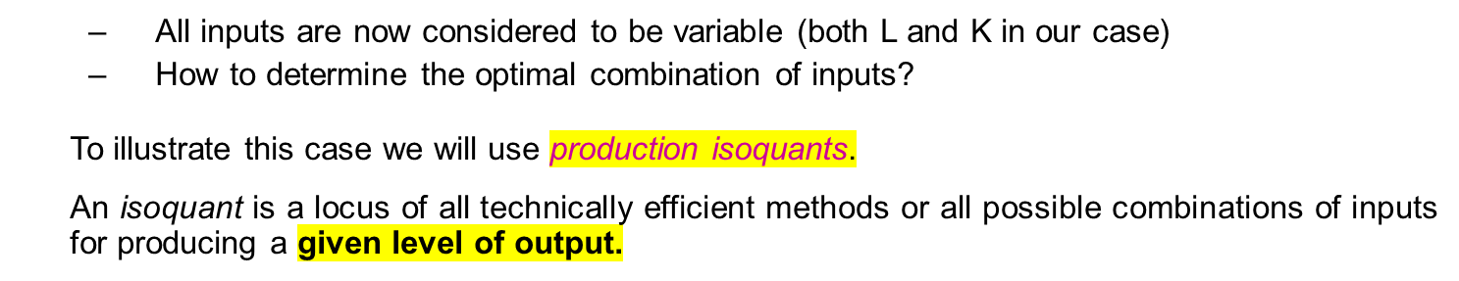
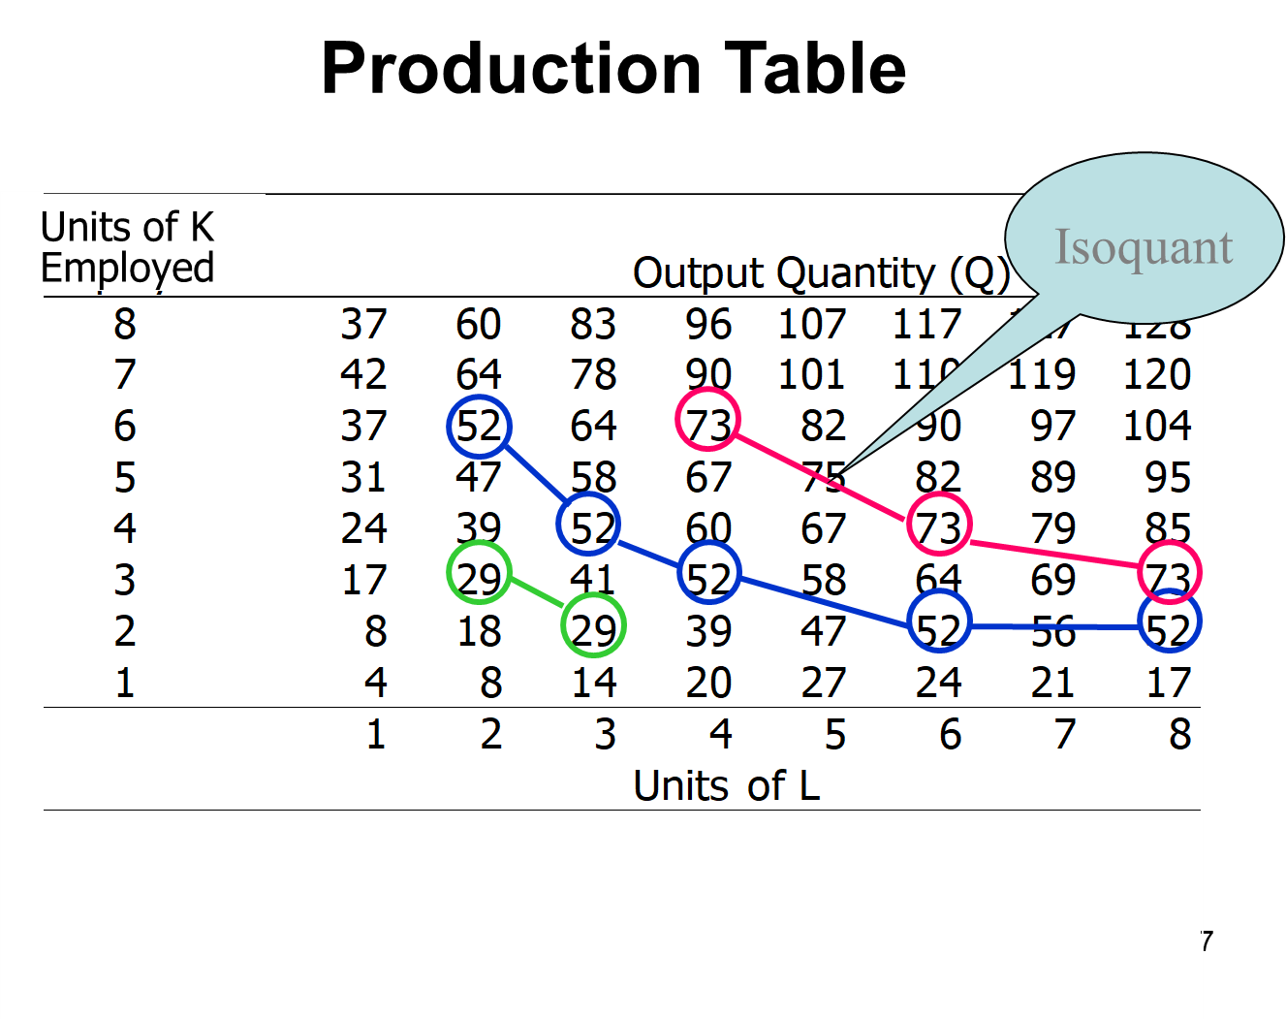
It helps in identifying the rational and irrational stages of operations.
It gives answers to question –
How much to produce?
What number of workers to apply to a given fixed inputs so that the output is maximum?

Slide 7

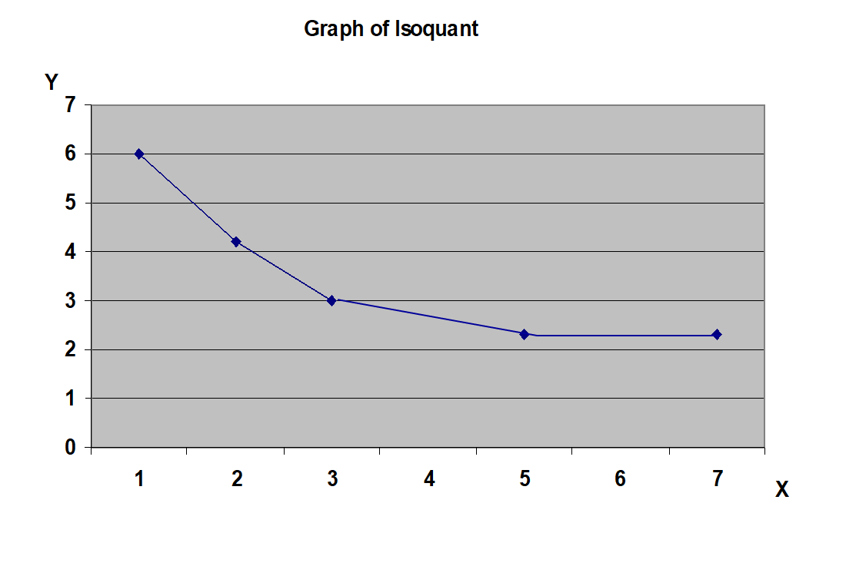
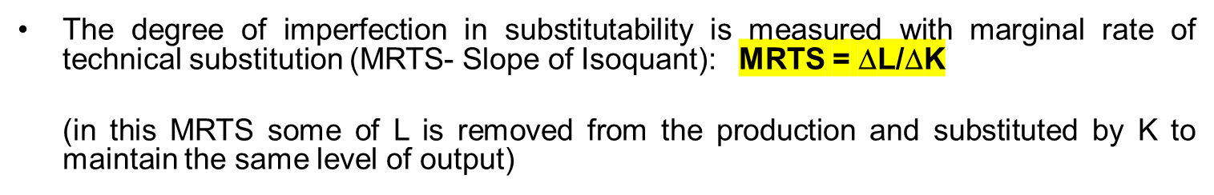
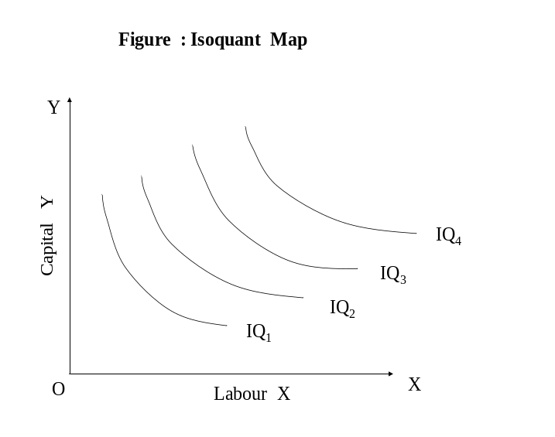

Properties of Isoquants
Isoquants have a negative slope.
Isoquants are convex to the origin.
Isoquants cannot intersect or be tangent to each other.
Upper Isoquants represents higher level of output
Isoquant map is a set of isoquants presented on a two dimensional plain. Each isoquant shows various combinations of two inputs that can be used to produce a given level of output.

Slide 8
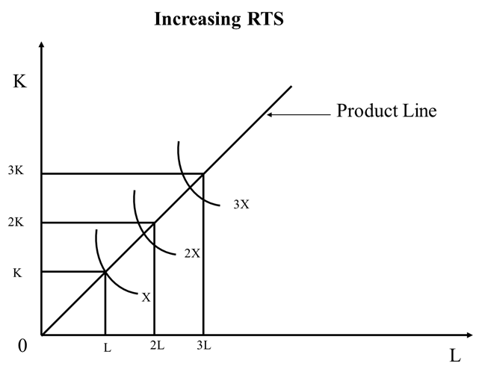
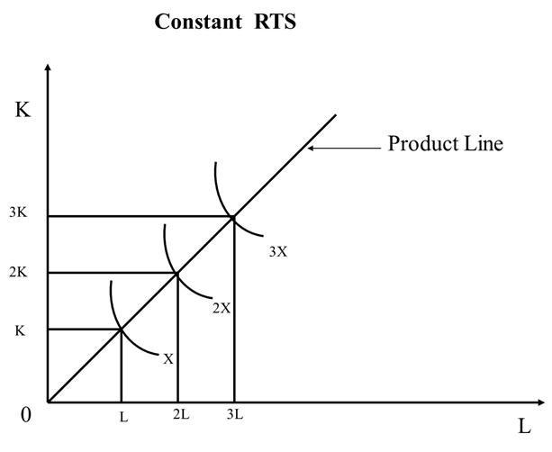
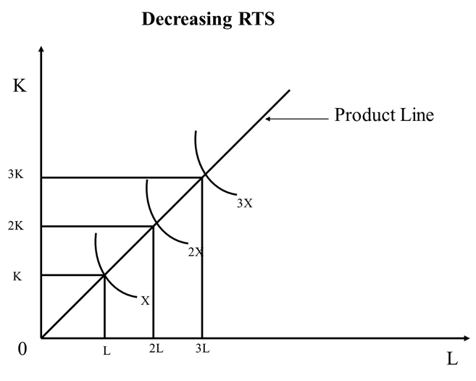
It explains the behavior of output in response to a proportional and simultaneous change in input.
When a firm increases both the inputs, there are three technical possibilities –
TP may increase more than proportionately – Increasing RTS (output inc at higher proportion as inc in input)
TP may increase proportionately – constant RTS (output inc at same proportion as inc in input)
TP may increase less than proportionately – diminishing RTS (output inc at lower proportion as inc in input)
( ) is formally defined as the percentage change in the capital labour ratios (K/L) divided by the percentage change in marginal rate of technical substitution (MRTS), i.e
Percentage change in K/L
( )=
Percentage change in MRTS
д(K/L) / (K/L)
( )=
д(MRTS) / (MRTS)

Slide 9
Cobb – Dougles Production function: -
X= b₀ L^{b1} K^{b2}
X= Out put
L = qty of Labour
K = qty of Capital
bo , b₁ , b₂ Coefficient
b1 - Labour
b2 - Capital
Characteristics of Cobb – Dougles Prodn function: -
2. The Marginal rate of technical substitution
The Marginal Product of Factor:
(a) MP _{L} = dx/dl
X = b₀L^{b1}K^{b2}
dx/dl = b₀ b₁ L^{b1-1}K^{b2}
= b₁ (boL^{b1} K ^{b2}) L⁻¹
= b₁ X/L
= b₁ (AP _{L})
AP_{L} Average Product of Labour
Similarly
(b) MP _{K} = dx/dk
= b₂ b₀L^{b1}K^{b2-1}
= b₂ ( b₀ L^{b1} K^{b2}) K⁻¹
= b₂ X/K
AP_{k} Average Product of Capital
MRTS _{L.K} = MP_{L}
MP_{K}
= dx/dL = b₁(X/L)
dx/dk b₂(X/K)
MRTS _{LK} = b₁ K
b₂ L

Slide 10
3. The Elasticity of Substitution
σ = Δd k/L / k/l
dMRTS / MRTS
= dK/L/k/L
b₁ dk b₁ k
b₂ L b₂ L
EOS =1
This function is perfectly substitutable function.
4.Factor intensity: -
In cobb-Douglas function factor intensity is measured by ratio b1/b2.
The higher is the ratio (b1/b2), the more labour intensive is the technique.
Similarly, the lower the ratio (b1/b2) the more capital intensive is the technique.
OR
b1/b2 labour intensive
b1/b2 capital intensive

Slide 11
5. Returns to scale:-
In cobb – Dougles production function RTS is measured by the sum of the coefficients
b₁+b₂ = V
x ₀= f (L,K)
X*= f(_{k}L, _{K}K)
A homogenous function is a function such that if each of the inputs is multiplied by K i.e ‘K’ can the completely factored out. ‘K’ also has a power V which is called the degree of homogeneity and it measures RTS.
X*= K^{v} f(x₀)
X₀ = b₀ L ^{b1} K ^{b2}
X* = b₀ (kL) ^{b1} (kK)^{b2} = K^{b1+b2} (b_{o} L ^{b1} K ^{b2}) = K^{v} f (X₀)
(V=b₁ + b₂)
∴ X* = K ^{v} f (X_{o})
In case when
V=1 we have constant RTS
V>1 we have increasing RTS
V<1 we have decreasing RTS
6.Efficiency of Production
The efficiency in the organization of the factor of production is measured by the coefficient b₀ :-
If two firms have the same K, L, b₁, b₂ and still produce different quantities of output, the difference can be due to superior organization and entrepreneurship of one of the firms, which results in different effectiveness.
The more efficient firm will have a larger b₀ than the less efficient one.
b₀ More efficient is firm

Slide 12
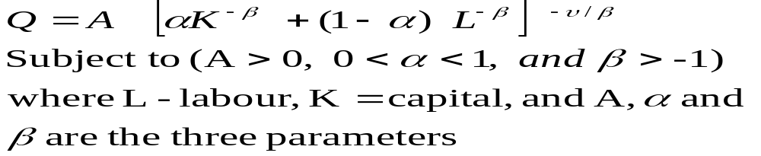
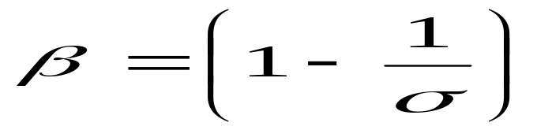
Constant Elasticity Substitution (CES) Production Functions
The CES production function is expressed as
‘A’ is the efficiency parameter and shows the scale effect. It indicates state of technology and entrepreneurial organizational aspects of production.
Higher Value of A higher output (given same inputs)
 is the capital intensity factor coefficient and (1- ) is the labour intensity of coefficient . The value of  indicates the relative contribution of capital input and labour input to total output.
Value of Elasticity of Substitution () depends upon the value of substitution parameter ‘β’
The parameter v represents degree of returns to scale.
Marginal Products of labour and capital are always positive if we assume constant return to scale.

Slide 13
Equilibrium of the firm: Choice of optimal combination of factors of prod^{n}
Assumptions:
1. The goal of the firm is profit maximization i.e maximization of difference
  ∏ - Profit
  R- Revenue
  C-Cost
  2. The price of o/p is given, Px
  3. The price of factors are given w is the given wage rate r is given price capital
Single Decision of the firm
(a) Maximize profit ∏, subject to cost constraint. In this case total cost & prices are given and maximization of ∏ is if X is maximised since c & Px are given constant.
        ∏ = R-C
        = P _{x} X-C
(b) Maximise Profit ∏ for a given level of o/p. Maximisation of ∏ is achieved in this case if cost c is minimized , given that X & Px are given constants.
        ∏= R-C
        ∏= P_{x}X - C

Slide 14
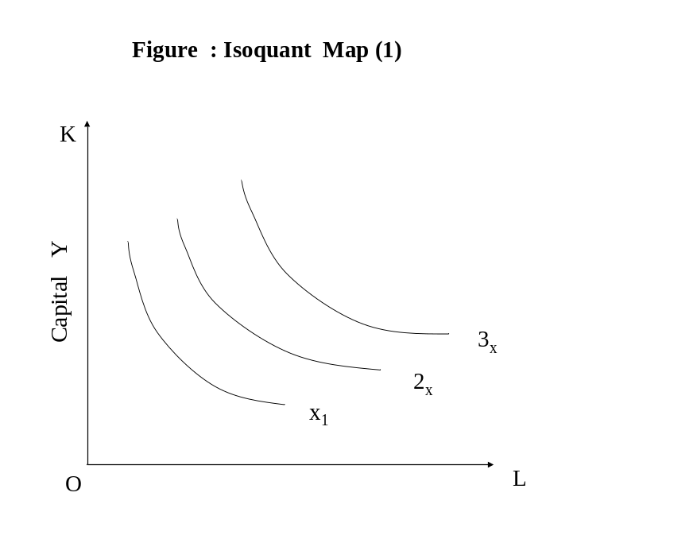
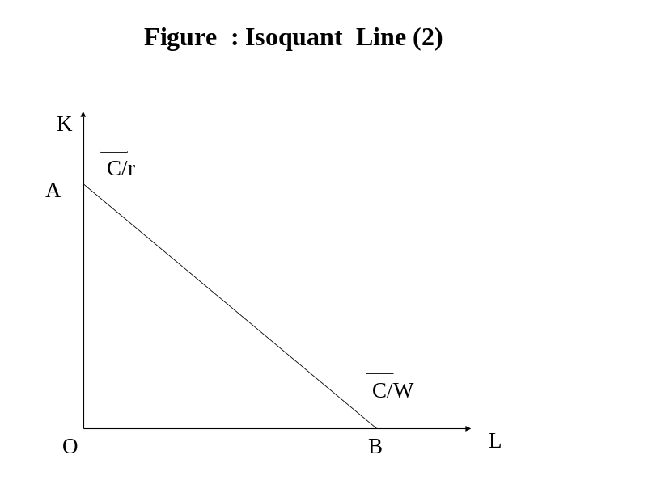
We will use isoquant map (1) and isoquant line (2)
The cost line is defined by cost equation
C= (r) (k) + (w) (L)
W wage rate r= price of capital service

Slide 15
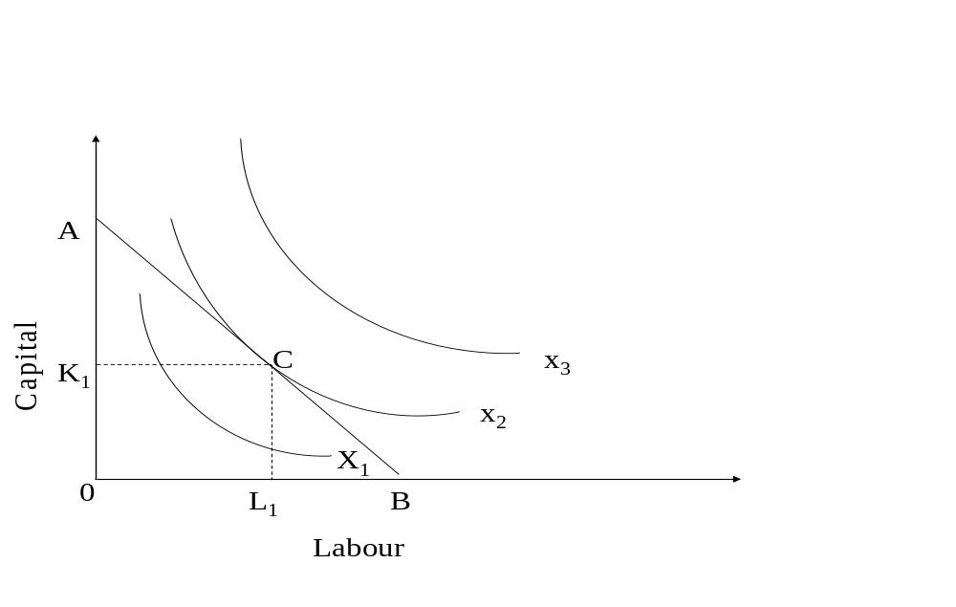
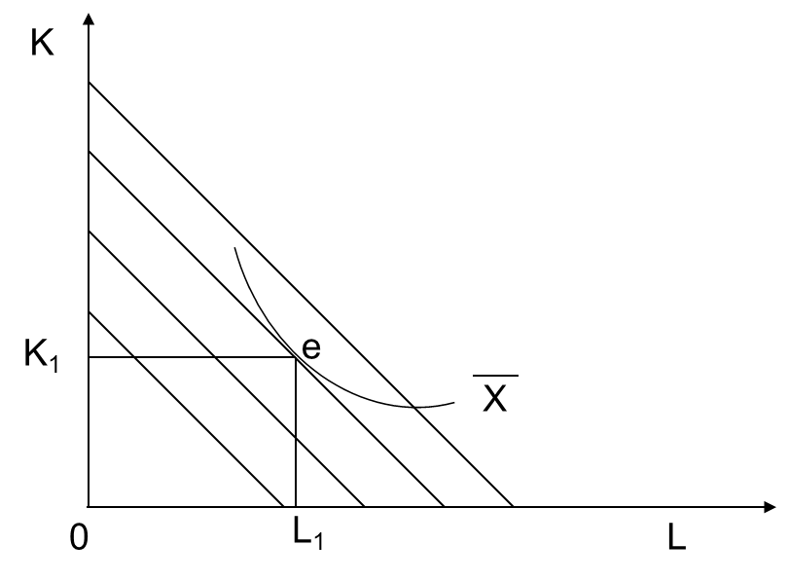
Case I
Maximization of output subject to cost constraint
Condition for Equilibrium
At point of tendency slope of isocost line (w/r ) = slope of isoquant. (MP_{L}/MP_{K})
The isoquants should be convex to origin
Case II
Minimization of cost for given level of output

Slide 16
Given the following production function and input prices, estimate the the optimum input combination of L and K, assuming that the firm has only Rs. 6000/- to spend.
Additionally, assume profit maximization as the objective function of the firm:
Q=LK-80L
P_{L}^{=60, Pk=30}
Slope of isoquant curve = - mpl/mpk
Slope of isocost curve = -pl/pk
Mpl/mpk=pl/pk=60/30=2
Mpl=d(q)/d(l)= k-80
Mpk= d(q)/d(k)= l
K-80/l=2
=>K-80=2l
K*pk+l*pl=6000
=>K*30+l*60=6000
=>K+2l=200
=>2k-80=200
K=140
L=30

